Slide 1
Chat Tool Application
Iteration 02

Slide 2
Iteration 01 Recap
Team re-org
General code cleanup
Bug fixes
Build/Test documentation
New Site Style
Our mission was to cleanup the chat application code-base. Lots of small stories; easy to complete.

Slide 3
Goals for Iteration 02
Refactor Room implementation
Documentation
Test reorganization & cleanup
Our mission is to encapsulate the central feature of the chat tool (the Room), as well as provide a better understanding of its implementation to future developers.

Slide 4
Documentation
Document for tracking the state of the chat application
Summarizes features implemented over time
Provides a location for “Known Issues” to be communicated to future developers
Chat Application Control Flow Diagram
Provides conceptual understanding of code
Database Entity-Relationship-Diagram (ERD)
Provides understanding of the data

Slide 5
Test Reorganization
Benefits:
Facilitates faster TDD
Provides easier Continuous Integration in the future
All test code under one root instead of distributed across file tree
Test code cleanup to reduce burden of understanding
Tests for “dead” code have been deleted
Tests that “pass” by default have been deleted
Renamed test files for clarity
Unit tests organized according by application
Example: tests for Issue Tracker can be found under: root/tests/unit_tests/issue_tracker
Selenium tests organized by application
Example: root/tests/selenium_tests/issue_tracker

Slide 6
Problem With Current API
Unscalable
All rooms and messages are loaded at runtime
Unbookmarkable room
There is no room URL
Too complicated to implement further core features

Slide 7
Refactored RestAPI
Unique room url
Each room now have different URL that needs appropriate permission to enter
This help with further implementation of private room/chat
Bookmarkable for invitation
Install requests for any room/user messages
Scalable

Slide 8
Project Metric
Added automated metrics gather script
Comparison metrics between current iteration and previous ones

Slide 9
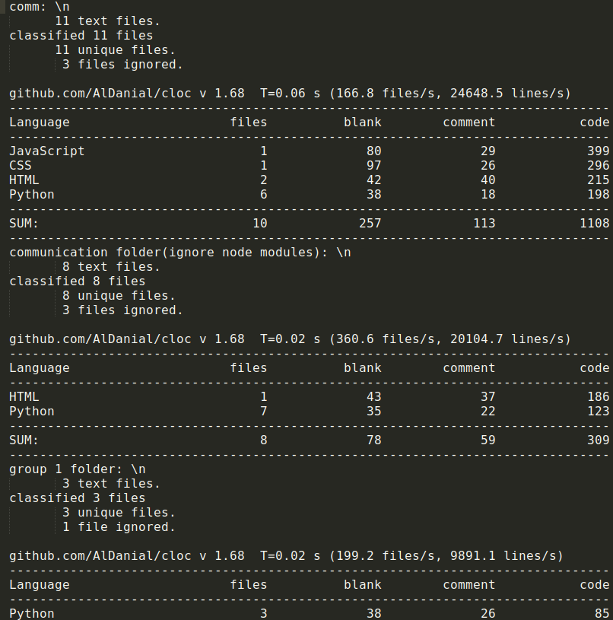
Current Metric

Slide 10
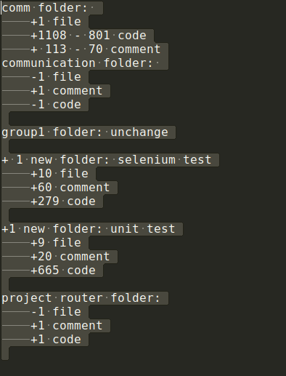
Comparison Metric

Slide 11
Message Character Limit
Requirements:
Restrict maximum(1000) and minimum(1) characters a message can have.
When users reaches the maximum or minimum character limit a warning message is displayed
Implementation:
Created a function to check length of message on key press
The function restrict number of characters and display a warning message
Test:
Insert more than 1010 character, warning message should display.

Slide 12
Edit Team Name
The team creator should have the ability to edit the name of the chat in case of an error or change
Tasks:
Differentiate creator from non creator
Add edit button from the options drop down menu
Create Edit Team modal
Create a method to update the value of the team in the database

Slide 13
Delete Team
Using the already existing edit team pop up box, a room creator should have the option to delete the team
Tasks:
Add method that deletes the team, and all of the messages, from the database
Add a delete button to the Edit Team modal
Create a confirmation pop up

Slide 14
Questions?

